Slide 1

Nintendo Switch
Sales Prediction
Team 6 Xinbei Jin | Sichun Li | Ze Long | Hongyuan Zhu

Slide 2

1
2
3
4
Data Exploration
Predictive Analysis
Model Performance
Result Interpretation

Slide 3

Data Exploration

Slide 4

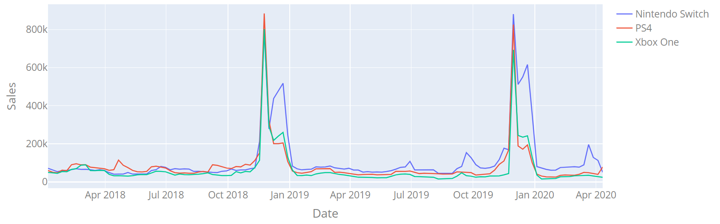




Weekly sales in the US ( Jan 1/2018 - Apr 11/2020)
Strong time pattern: Black Friday and Christmas
Release of popular game series

Slide 5
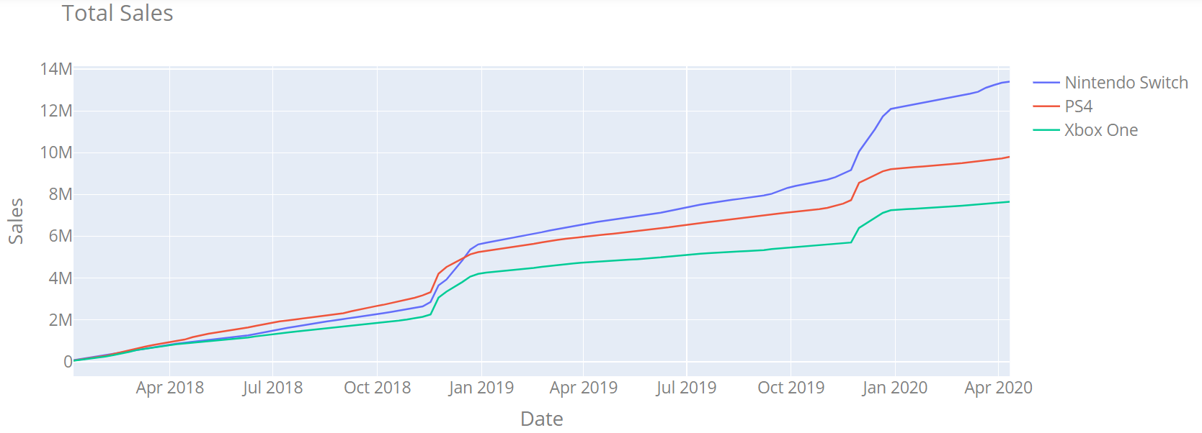
Total sales in the US ( Jan 1/2018 - Apr 11/2020)
Nintendo Switch outsold PS4 in the end of 2018 in the US

Slide 6

Predictive Analysis
——
Machine Learning

Slide 7
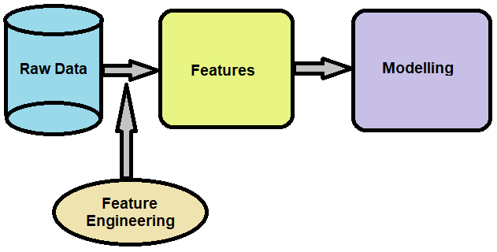

Feature Engineering
Modify the raw data to make them capable of being used by most predictive algorithms

Slide 8
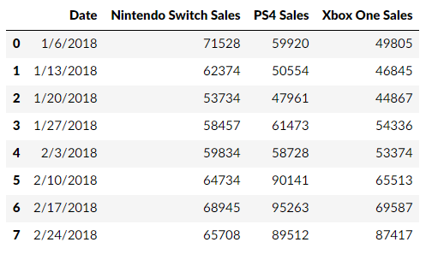
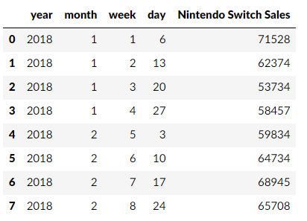
Feature Engineering
Extract year, month, week, day from original date variable
Drop useless variables

Slide 9
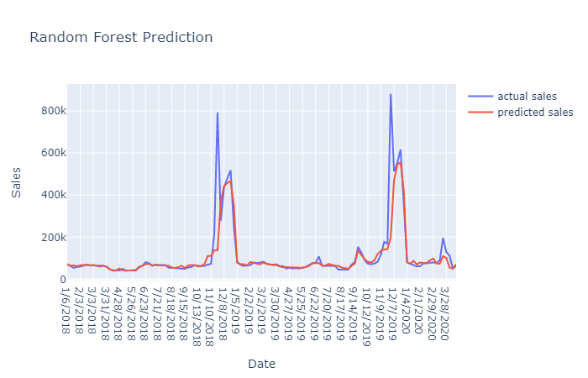
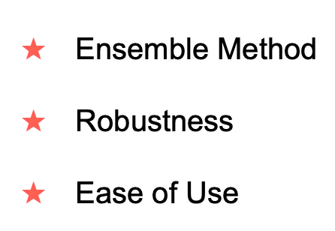
Modeling - Random Forest
Modify the raw data to make them capable of being used by most predictive algorithms

Slide 10
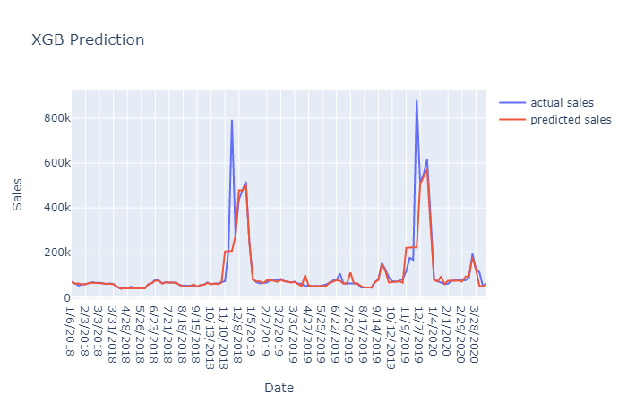
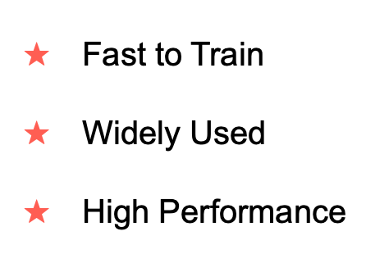
Modeling - Extreme Gradient Boosting (XGB)

Slide 11
Predictive Analysis
——
Deep
Learning

Slide 12
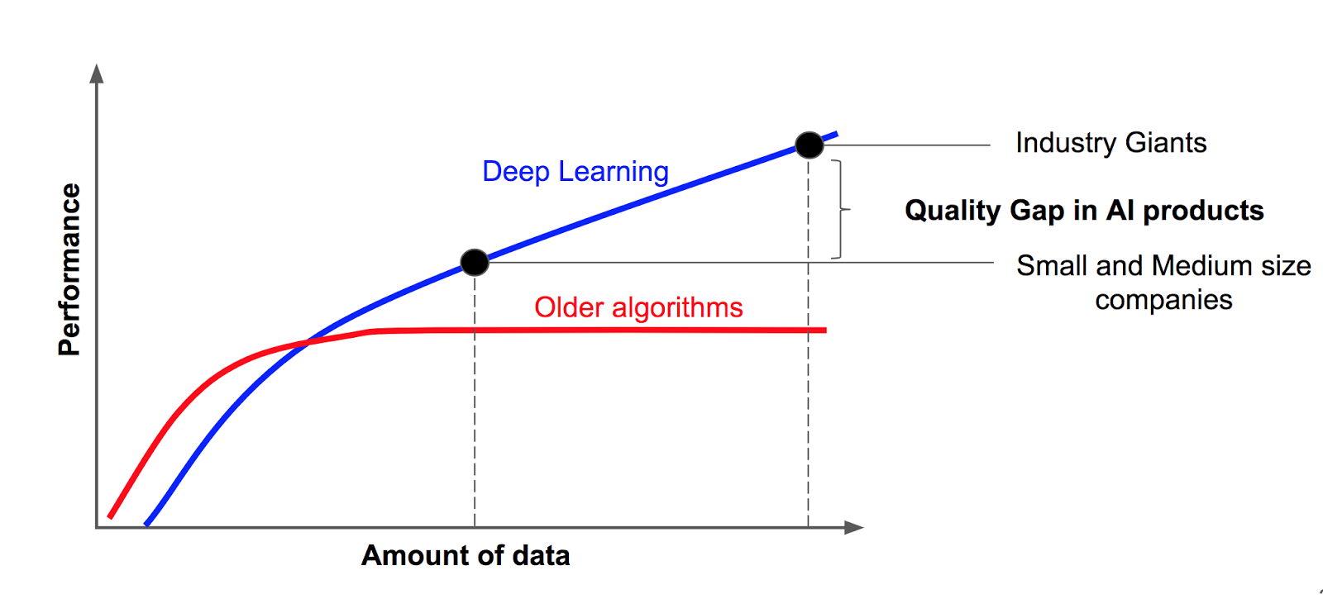

Why Deep Learning
Simulate biological neural networks
Often achieve higher performance in industrial or big data

Slide 13
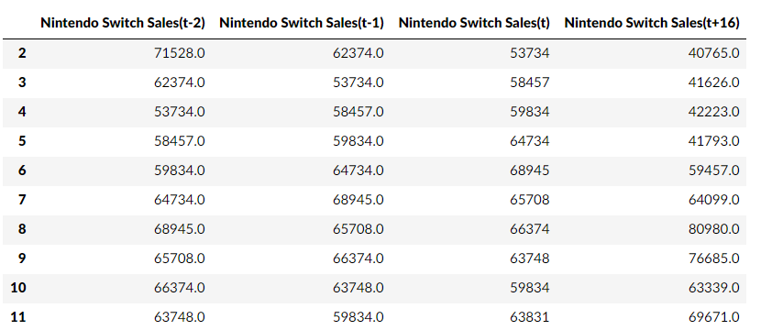
Feature Engineering
Use current (t) and previous 2 days’ (t-1, t-2) data to forecast sales in 16 days

Slide 14
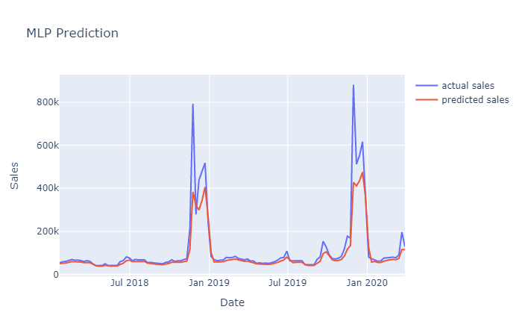
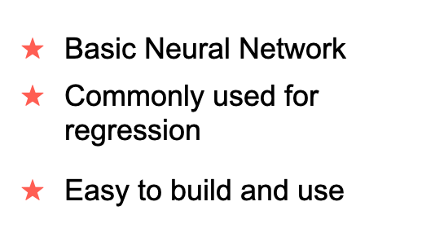
Modeling - Multilayer Perceptron (MLP)
Modify the raw data to make them capable of being used by most predictive algorithms

Slide 15
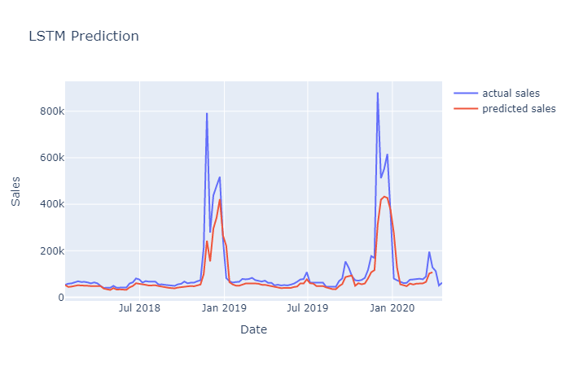
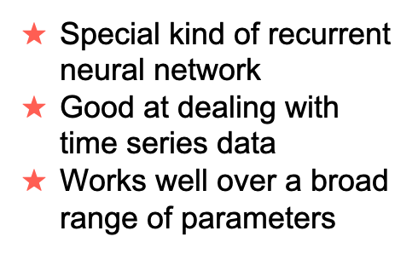
Modeling - Long Short-Term Memory (LSTM)

Slide 16
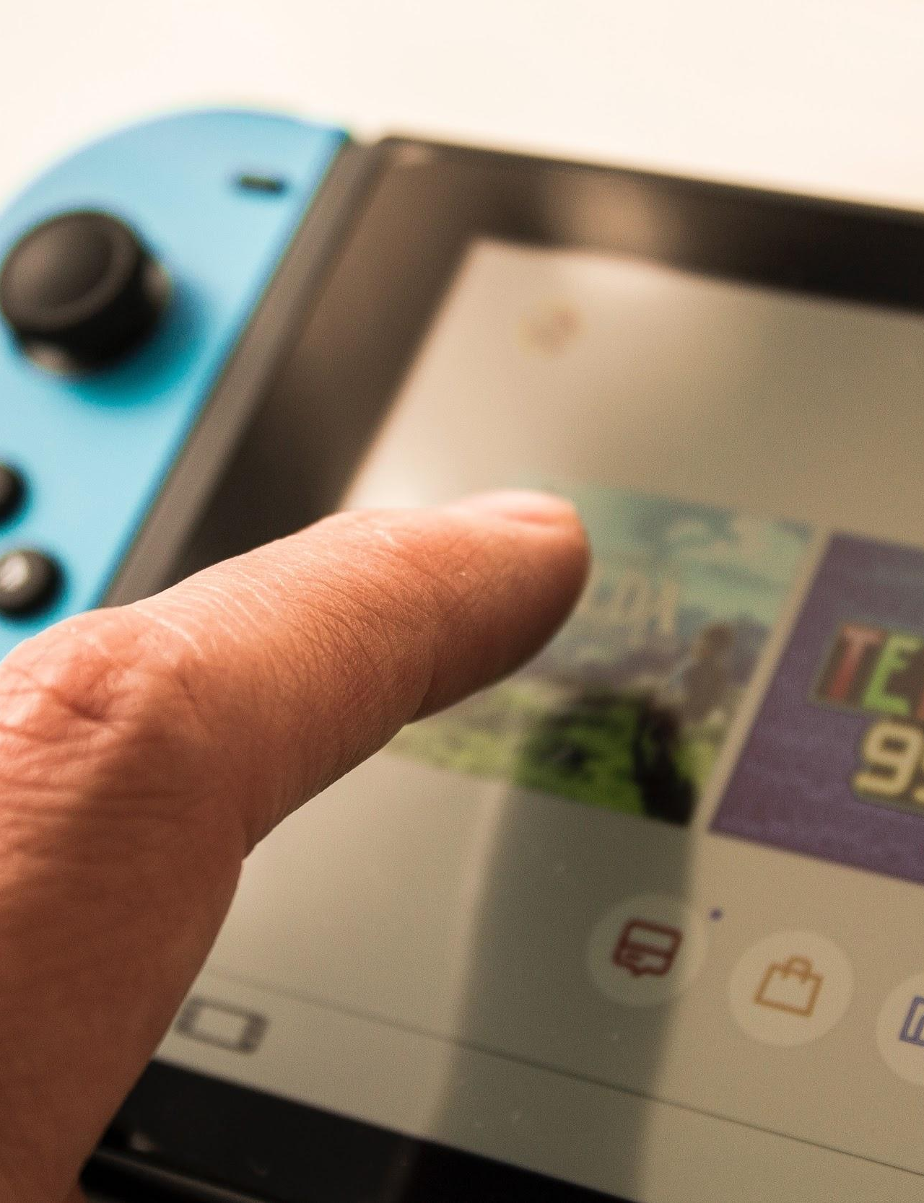
Model Performance

Slide 17

Sensitivity Analysis Based on MAE
Random Forest XGB MLP LSTM
MAE 47193 52083 64821 61376
get reciprocal and normalize
weights 0.29 0.27 0.21 0.23
Final Sales Prediction for week ending on May,9
55,610
Prediction 51410 51552 57487 64076
*
times

Slide 18
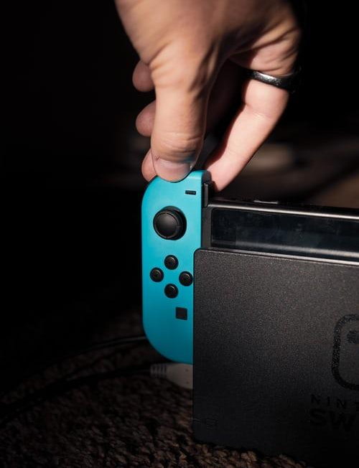
Result Interpretation

Slide 19
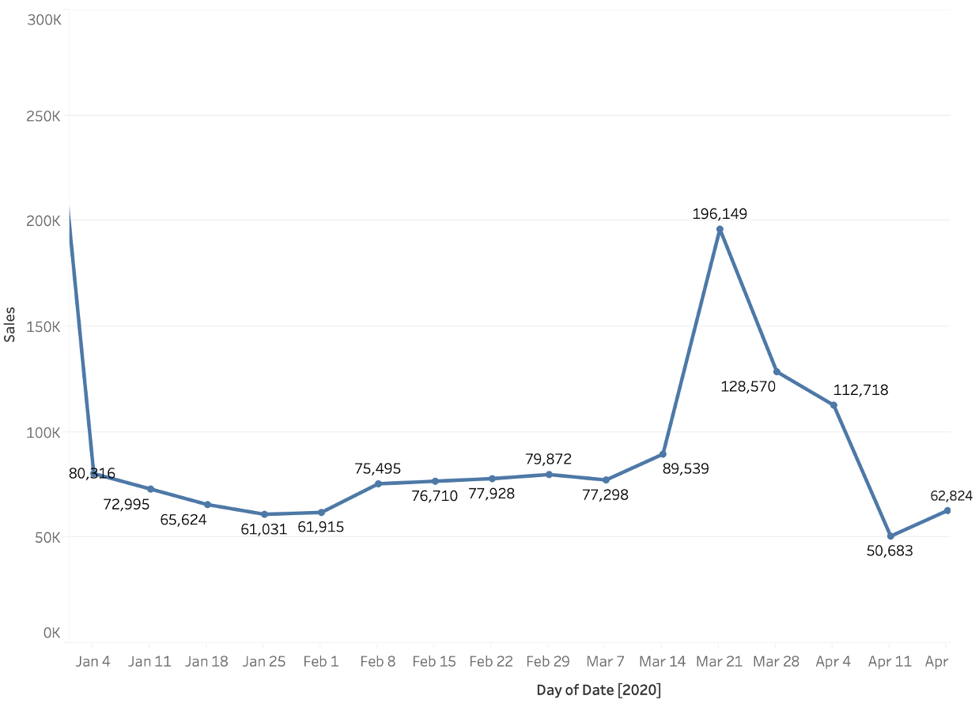
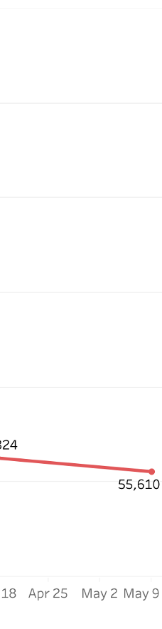
Sales of 2020 + Our prediction (55610)

Slide 20


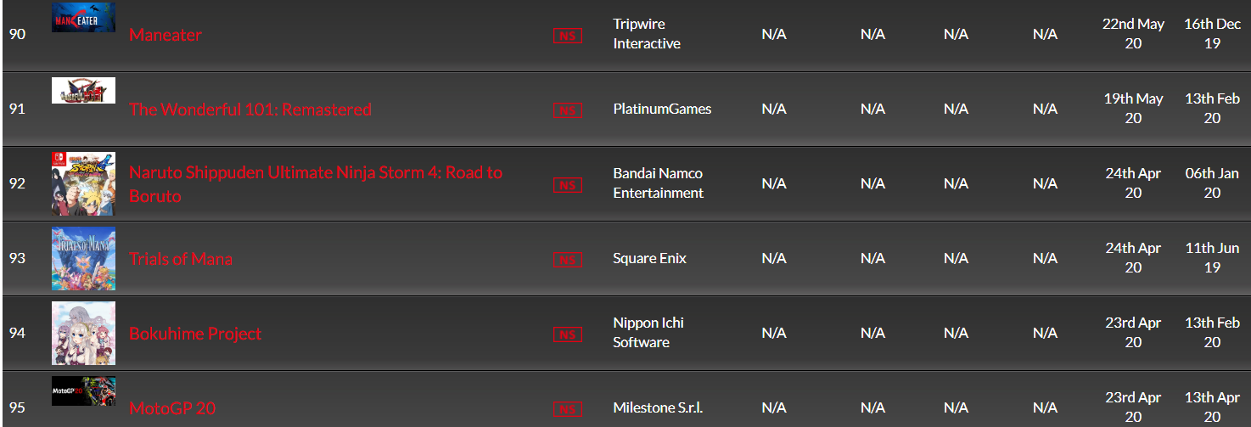
No new popular games to be released in the week
released on 20th Mar. 2020
a month ago
no new games released recently
Use current (t) and previous 2 days’ (t-1, t-2) data to forecast sales in 16 days
relatively stable sales in the week ending on May 9th

Slide 21
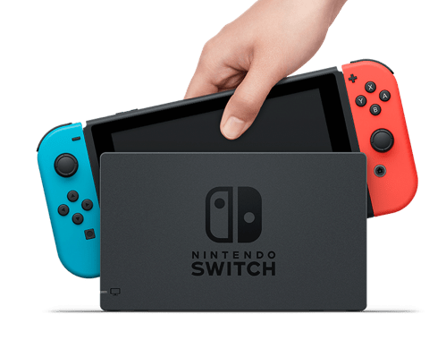
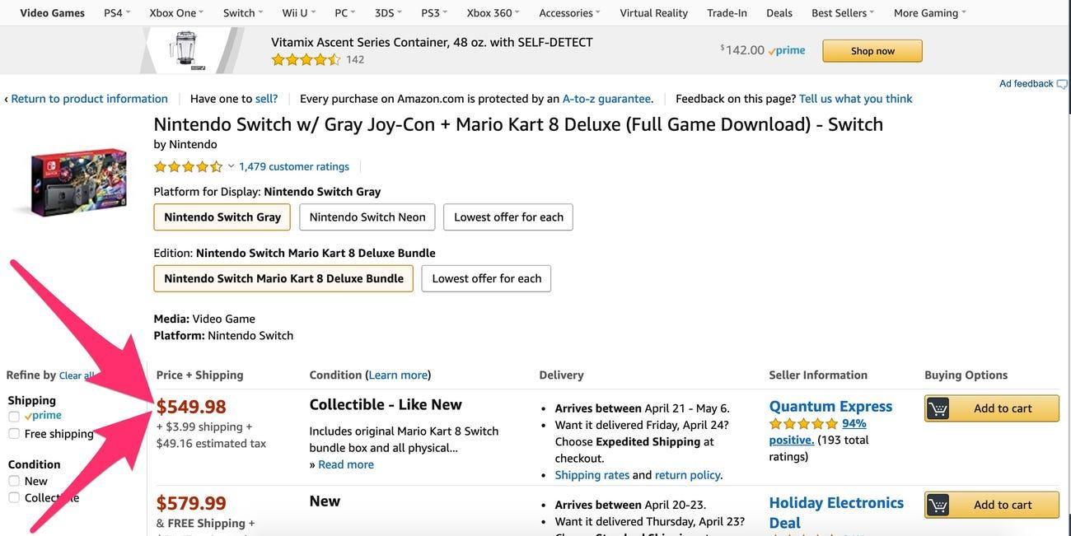

The impact of COVID-19 on sales
“We should start to see the Switch back in stores as early as June.”
(Source: Forbes, 4/20/2020)

Slide 22
Sales of 2020 + Our prediction (55610)

Slide 23

Q & A
Team 6
Xinbei.Jin@simon.rochester.edu
Sichun.Li@simon.rochester.edu
Ze.Long@simon.rochester.edu
Hongyuan.Zhu@simon.rochester.edu

